Slide 1
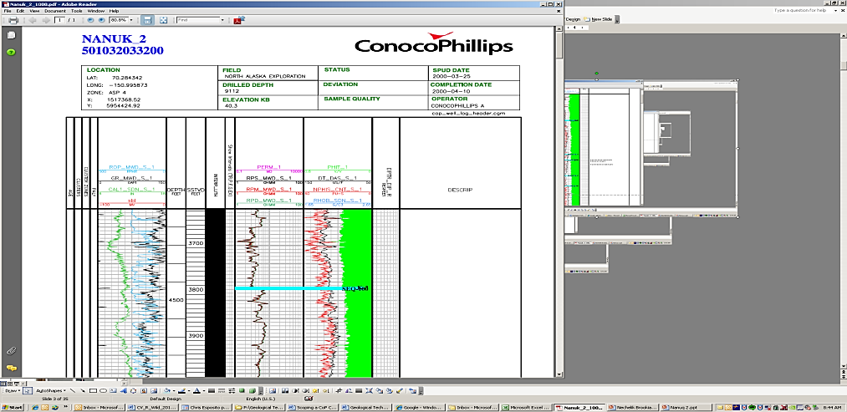
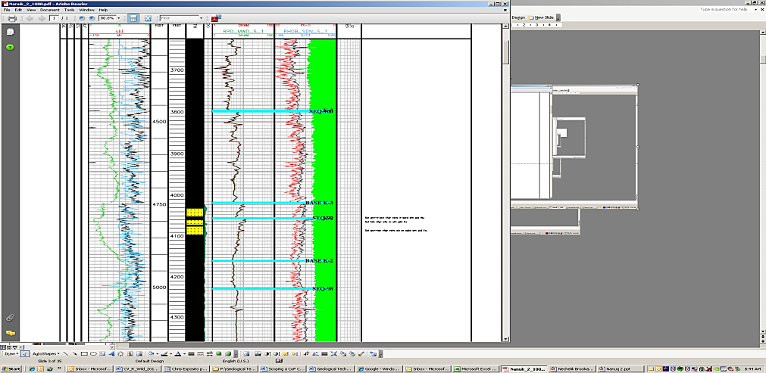
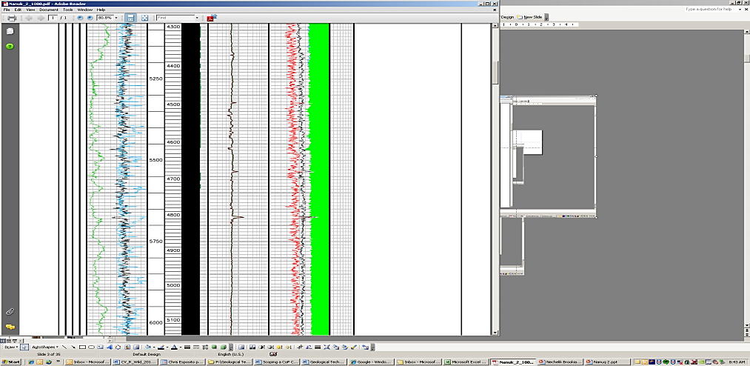
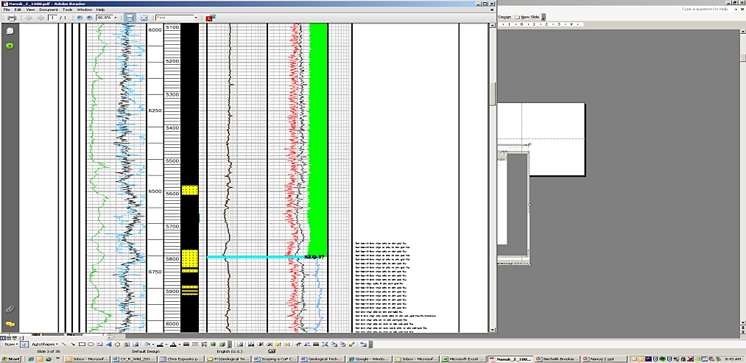
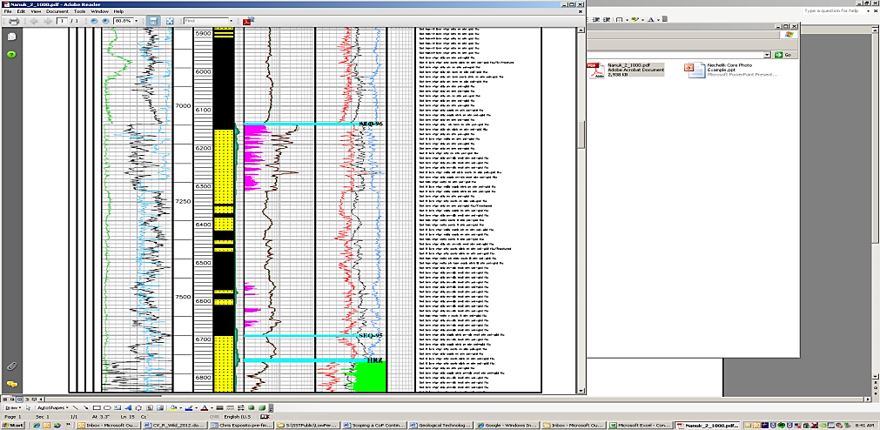
Composite Log
“Butterfly Display”
Opposing GR curves
Exercise 1
Basin Fill Motif
Divide the well log into large scale packages based on log motif. (3 to 5 packages)
Given the gross interval thickness, what do these divisions represent?
250ft

Slide 2
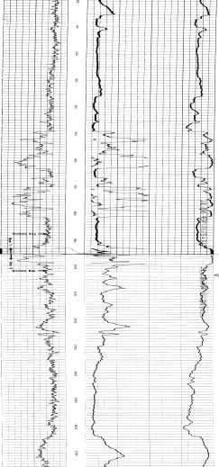
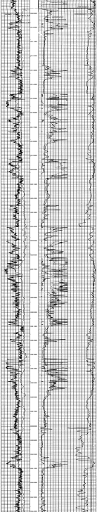
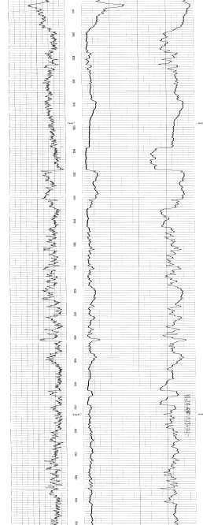
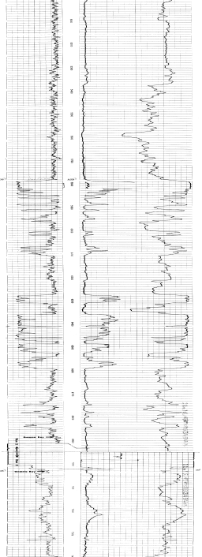
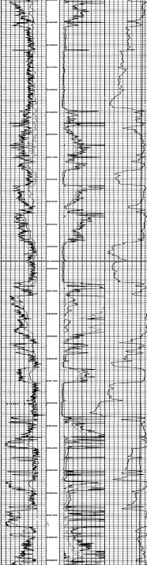
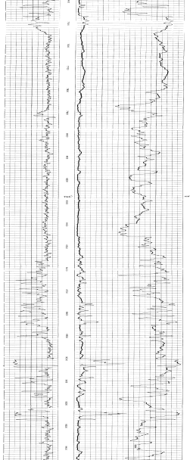
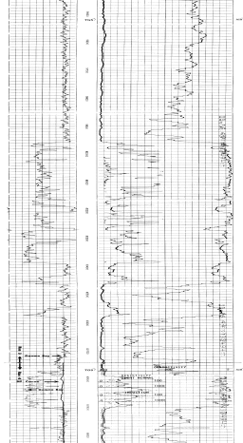
16 mi
1000 ft
Top Atoka Fm.
Datum: Top Upper Alma
Base Atoka Fm.
Compare the gross log motif between these wells.
Given the vertical scale, does this represent log motif at the depositional systems scale or the basin scale?
Can you suggest a proximal to distal transition?
Exercise 2: Basin scale log motif

Slide 3
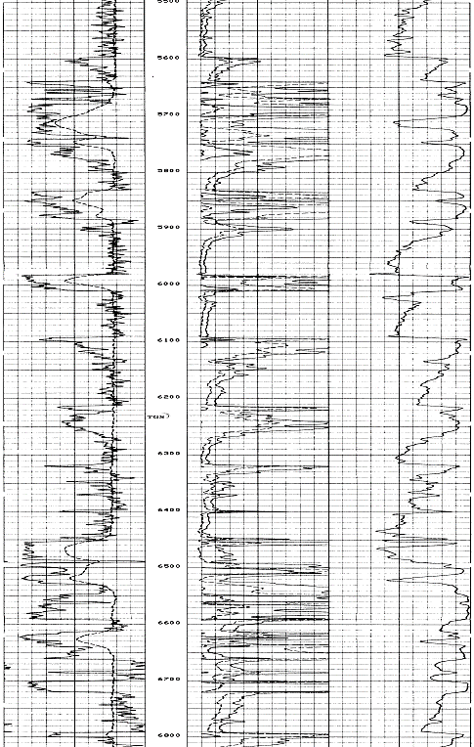
Exercise 3: Stratigraphic Cyclicity
Divide the well log into large scale packages based on log motif. (3 to 5 packages, 100 – 300ft in thickness)
Given the gross interval thickness, what do these divisions represent?
Do you see a pattern in vertical stacking?
Atoka
Morrow

Slide 4
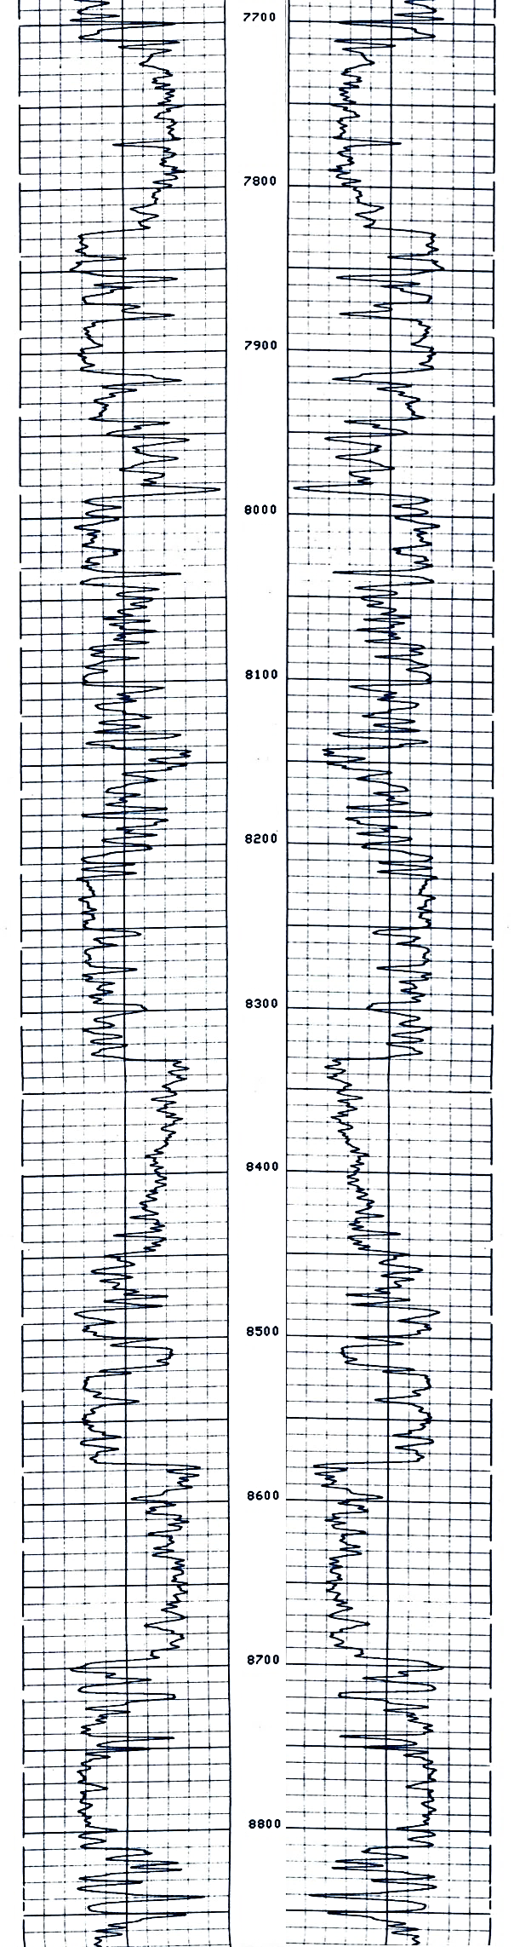
Exercise 5: Stratigraphic Cyclicity and Log Motif
Arco Expl. Peeler Gap 1-32
32-5N-22W
How many scales of cyclicity would you divide this deepwater succession into?
Can you speculate on stratigraphic architecture (layered sheets, amalgamated sheets, etc.) or depositional elements based on log motif (lobe complex, channel/levee etc.)?

