Slide 1
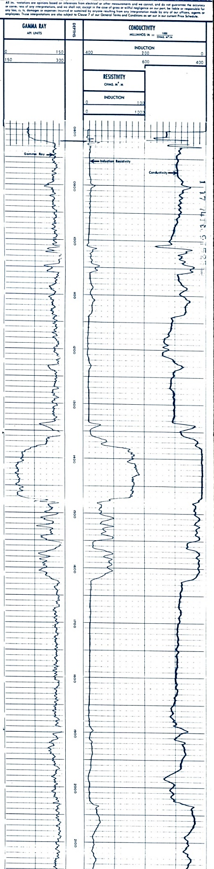
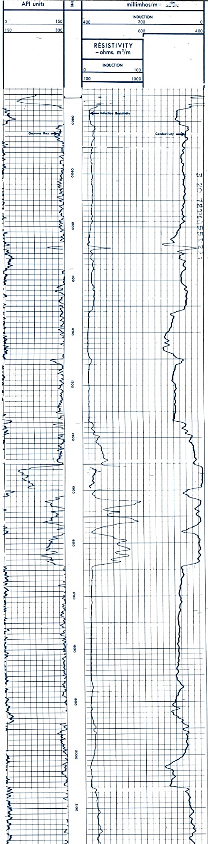
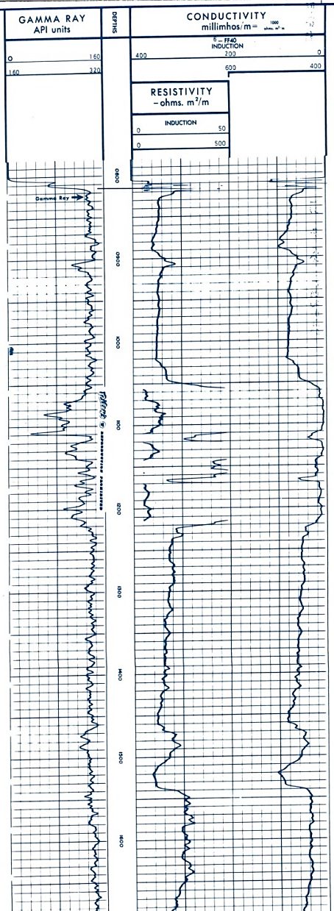
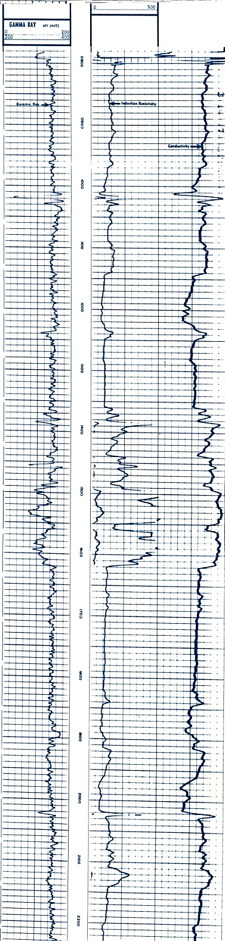
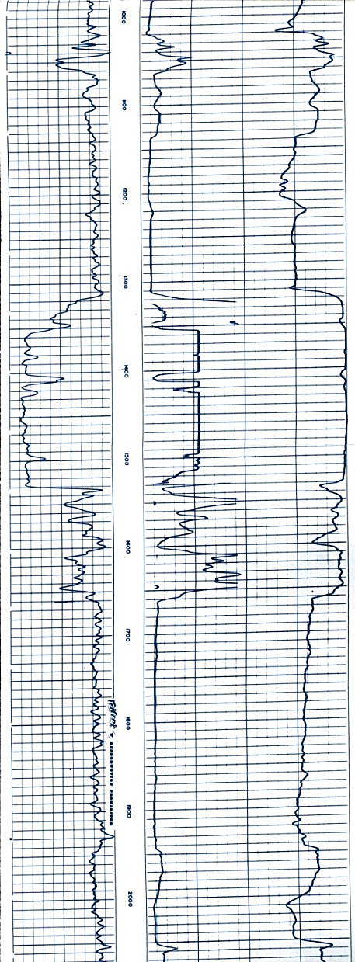
Exercise 4:
Log Motif Correlation
This is an oblique strike profile
The wells are ~1mile apart
1) What observations can you make about the log motif?
2) Correlate equivalent log motif facies.
3) Color and label the component depositional elements
4) Identify the reservoir facies/bodies and describe the degree of compartmentalization.

Slide 2
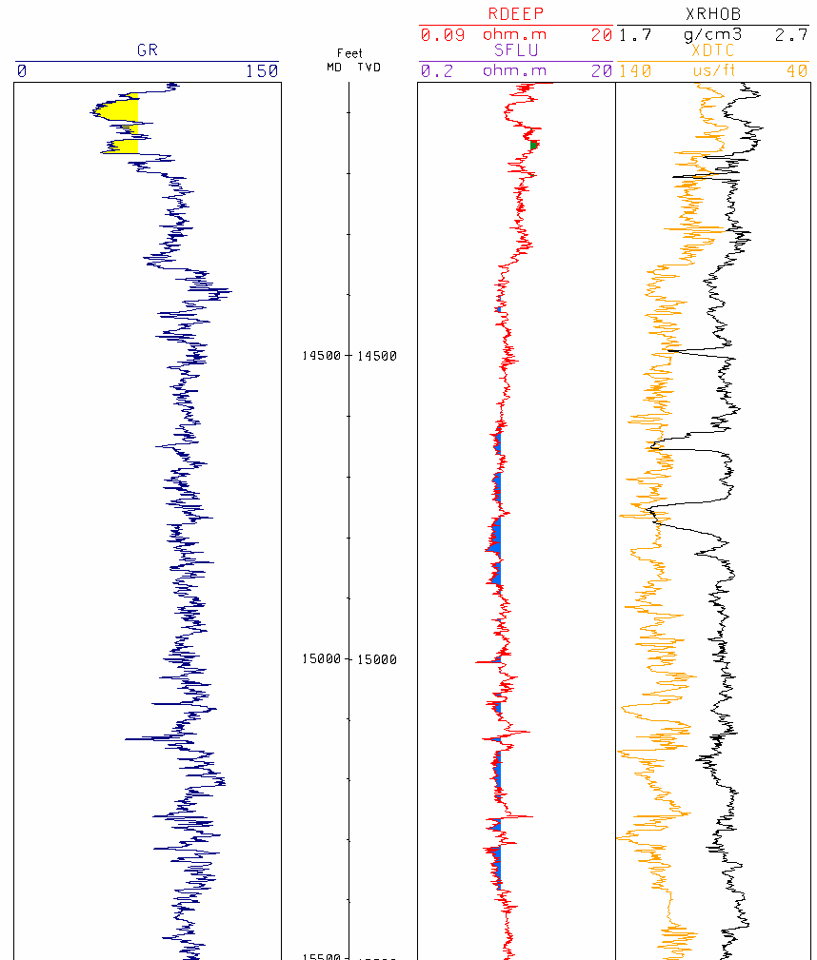
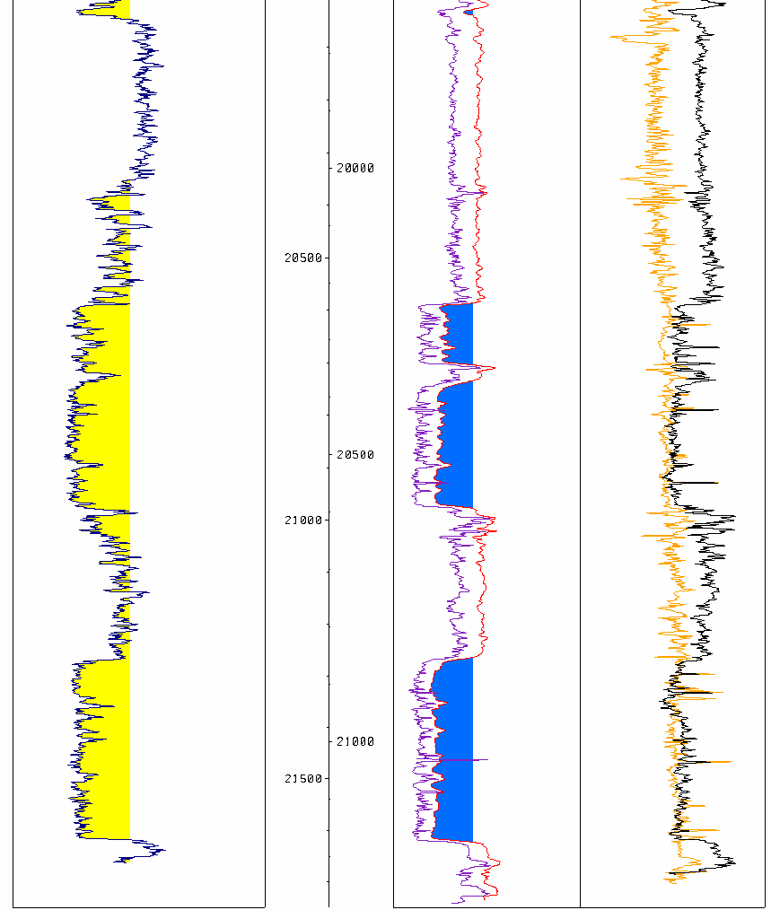
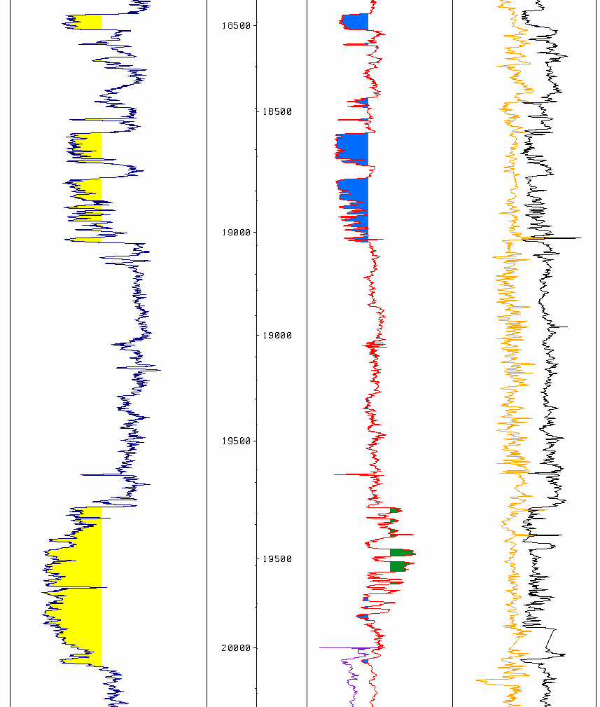
Exercise 6A: Log Motif (depositional cycles & facies) and Net:Gross
Vshale
cut off
Vshale
cut off
Gross Depositional Environment _______________________
Genetic Sequence Thickness _____________
Gross Reservoir Thickness ___________
Gross Clean Sand ____________
Net to Gross _______________
Gross Depositional Environment _______________________
Genetic Sequence Thickness _____________
Gross Reservoir Thickness ___________
Gross Clean Sand ____________
Net to Gross _______________
Gross Depositional Environment _______________________
Genetic Sequence Thickness _____________
Gross Reservoir Thickness ___________
Gross Clean Sand ____________
Net to Gross _______________
Gross Depositional Environment _______________________
Genetic Sequence Thickness _____________
Gross Reservoir Thickness ___________
Gross Clean Sand ____________
Net to Gross _______________

Slide 3
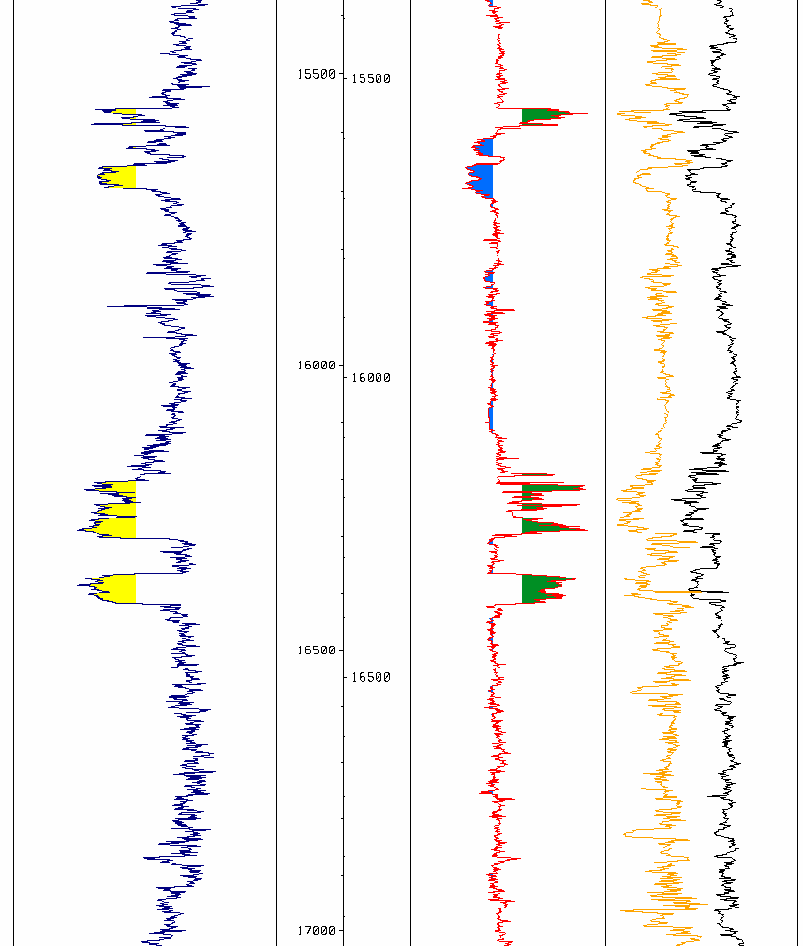
Exercise 6B: Log Motif (depositional cycles & facies) and Net:Gross
Vshale
cut off
Vshale
cut off
Gross Depositional Environment _______________________
Genetic Sequence Thickness _____________
Gross Reservoir Thickness ___________
Gross Clean Sand ____________
Net to Gross _______________
Gross Depositional Environment _______________________
Genetic Sequence Thickness _____________
Gross Reservoir Thickness ___________
Gross Clean Sand ____________
Net to Gross _______________
Gross Depositional Environment _______________________
Genetic Sequence Thickness _____________
Gross Reservoir Thickness ___________
Gross Clean Sand ____________
Net to Gross _______________
Gross Depositional Environment _______________________
Genetic Sequence Thickness _____________
Gross Reservoir Thickness ___________
Gross Clean Sand ____________
Net to Gross _______________

